Slide 1
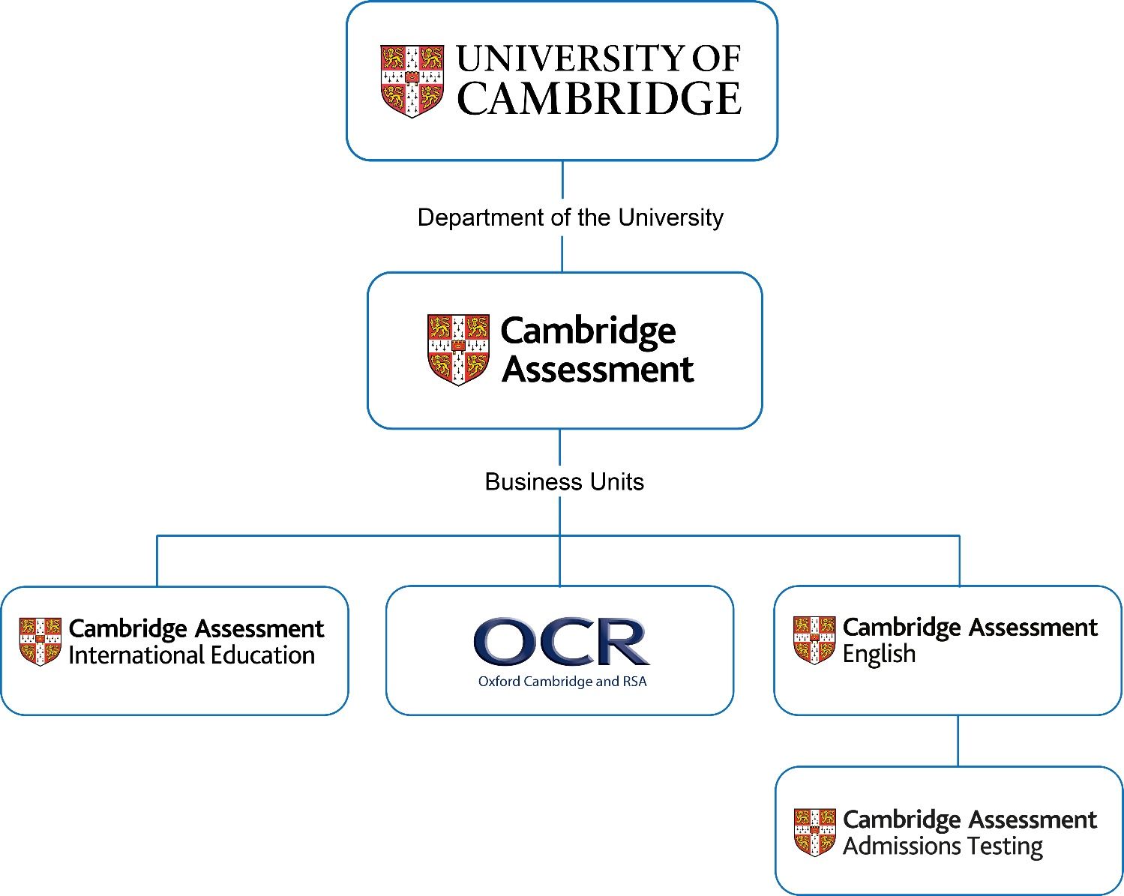
The Cambridge Assessment Group
Notes:
Cambridge Assessment International Education is part of the Cambridge Assessment Group, a not-for profit department of the University of Cambridge. We are proud to be part of one of the oldest and greatest universities in the world - renowned worldwide for excellence in education.
The Cambridge Assessment Group operates and manages the University’s three exam boards:
Cambridge Assessment International Education- the world’s largest provider of international education programmes and qualifications for 5 to 19 year olds
Oxford Cambridge and RSA Examinations (OCR for short) - a leading UK awarding body, committed to providing qualifications that engage learners of all ages at school, college, in work or through part-time learning programmes to achieve their full potential
Cambridge Assessment English – provider of the world’s leading range of certificates for learners of English.

Slide 2
Cambridge International School Logo
“We are a registered school of Cambridge Assessment International Education, the only exam board wholly owned by a world-leading university, the University of Cambridge”.
“As a Cambridge International School, we offer the Cambridge Primary, Lower Secondary, Upper Secondary, Advanced programmes for students aged 5 to 19 years”.

Slide 3
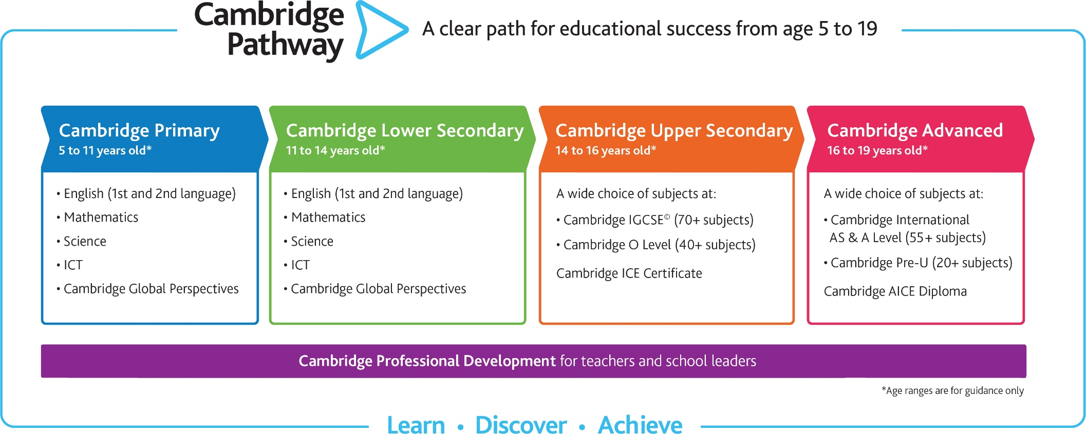
Cambridge Pathway
Notes:
The Cambridge Pathway gives students a clear path for educational success from age 5 to 19. Over 10 000 schools in more than 160 countries offer it.
Cambridge Primary
Cambridge Primary is taught in more than 1300 schools in over 110 countries.
Students develop skills and understanding in English as a first or second language, maths, science, Cambridge Global Perspectives and ICT. Many schools use the Cambridge Primary testing structure to assess learner performance and report progress to learners and parents.
Cambridge Lower Secondary
Cambridge Lower Secondary is taken in over 130 countries – nearly 2 300 schools around the world teach it.
We receive over 102 000 entries a year for Cambridge Lower Secondary Checkpoint, our tests for 11 to 14 year olds.
Students develop further their skills and understanding in English, maths and science. Cambridge Lower Secondary assessment uses internationally benchmarked tests, giving parents extra trust in the feedback they receive.
Cambridge Upper Secondary
Students build a broad learning programme from a wide range of subjects, developing skills in enquiry, creative thinking and problem solving.
They work towards either Cambridge IGCSE or Cambridge O Level qualifications. Both qualifications are internationally recognised and designed for an international audience.
Cambridge IGCSE is the world’s most popular international qualification for 14 to 16 year olds. They are taken in over 145 countries in more than 4800 schools worldwide.
Cambridge O Levels are taken in over 50 countries with 630 000 subject entries per year.
Cambridge International AS & A Level
Cambridge International AS & A Levels are taken in 134 countries with more than 525 000 subject entries per year.
Students develop the deep understanding and thinking skills they need for university.
They work towards Cambridge International AS & A Level qualifications – giving them the choice to specialise, or study from a range of over 50 subjects.

Slide 4
Cambridge Assessment
Assessment at end of the course.
Written, oral, coursework and practical assessment options give students opportunities to demonstrate learning.
Grades are A*–G, with A* being the highest; 1-9, with 9 being the highest.
Notes:
Assessment
Assessment takes place at the end of the course and includes written, oral, coursework and practical assessment.
This broadens opportunities for students to demonstrate their learning, particularly when their first language is not English.
With a tiered structure in many subjects for different ability levels, students of all abilities are assessed positively and bright individuals have the chance to excel.
The grades awarded at Cambridge IGCSE are A*–G, with A* being the highest.

Slide 5
National & International recognition
They are recognised as qualifications that prepare and equip students with the skills they need to succeed both at university and beyond.
http://recognition.cambridgeinternational.org
Notes:
Cambridge qualifications are accepted at over 1400 institutions across 195 countries, including top ranking universities around the world.
Learners use Cambridge International AS & A Levels to gain places at leading universities worldwide including in the UK, Ireland, USA, Canada, Australia, New Zealand, India, Singapore, Egypt, Jordan, South Africa, the Netherlands, Germany and Spain.
Cambridge International AS & A Levels are accepted for entrance to all UK universities.
In places such as the United States and Canada, good grades in carefully chosen Cambridge International A Level subjects can result in up to one year of university course credit.

Slide 6
Iscrizioni 2019
Sessione di maggio/giugno:
da metà dicembre entro il 31 gennaio 2019
Sessione di ottobre/novembre:
da metà maggio entro il 7 giugno 2019

Slide 7
Prospetto discipline
 | Classico | Scientifico | Linguistico
2° anno | Geography | Geography Art &Design | Geography Spanish
3° anno | English 2nd Language Latin Drama | English 2nd Language Maths Drama | English 2nd Language French Drama
4°anno | History Biology | History Physics Biology | History/Histoire English 1st Language

Slide 8
English as Second
Language 0511
Maths
0580
Geography
0460
9% - A (1)
0 - A
0 - A
33% - B-C
55% - B-C
100% - B-C
25% - D
Rest of
Italy
Rest of
Italy
42% - E-F-G
Rest of Italy
2% A*
13% A
9% A*
19% A
1% A*
7% A
28% B
35% C
24% B
31% C
16% B
29% C
29% D

Slide 9
Biology
0610
Physics
0625
100% - B-C (1)
50% - B-C (1)
50% - E-F-G (1)
Rest of
Italy
Rest of
Italy
11% A*
12% A
12% A*
19% A
20% B
24% C
26% B
24% C

Slide 10
INFO E CONTATTI Exams Officer prof.ssa Annalisa Lorelli
Email: prof.lorelli@gmail.com
Colloquio previo appuntamento

